Slide 1

Azure Community Conference 2021

Slide 2
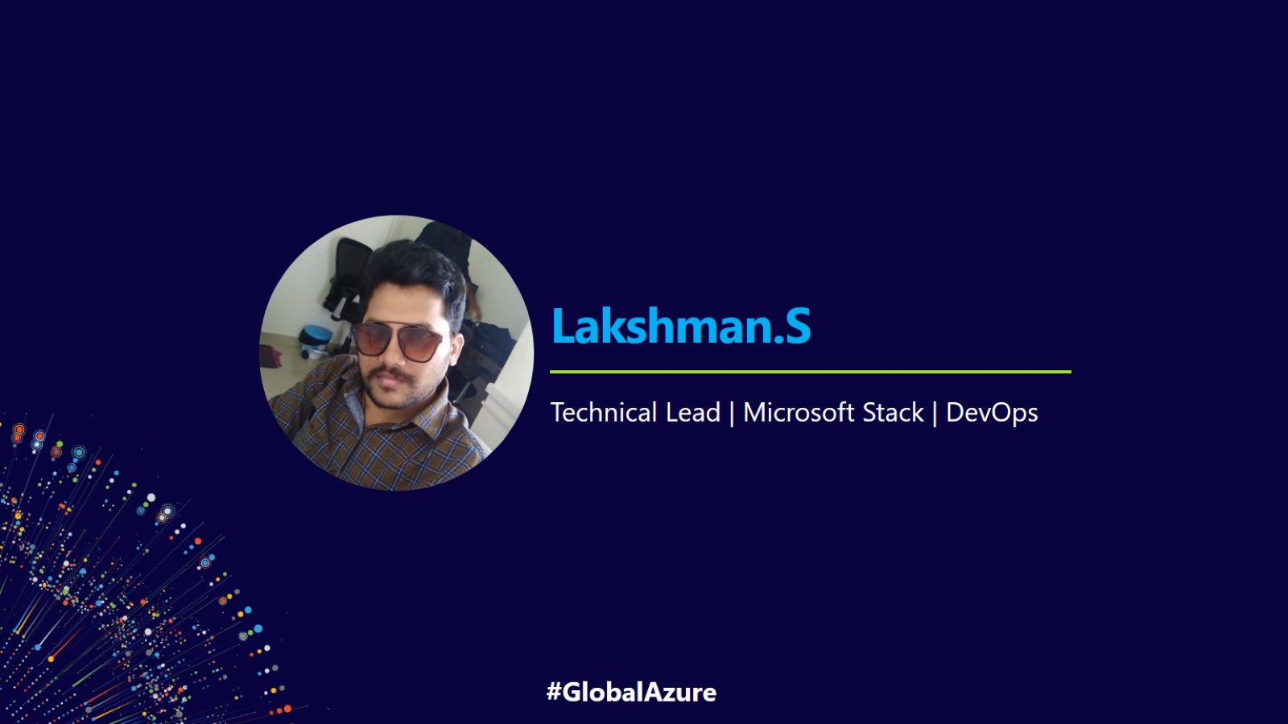
Lakshman.S

Slide 3
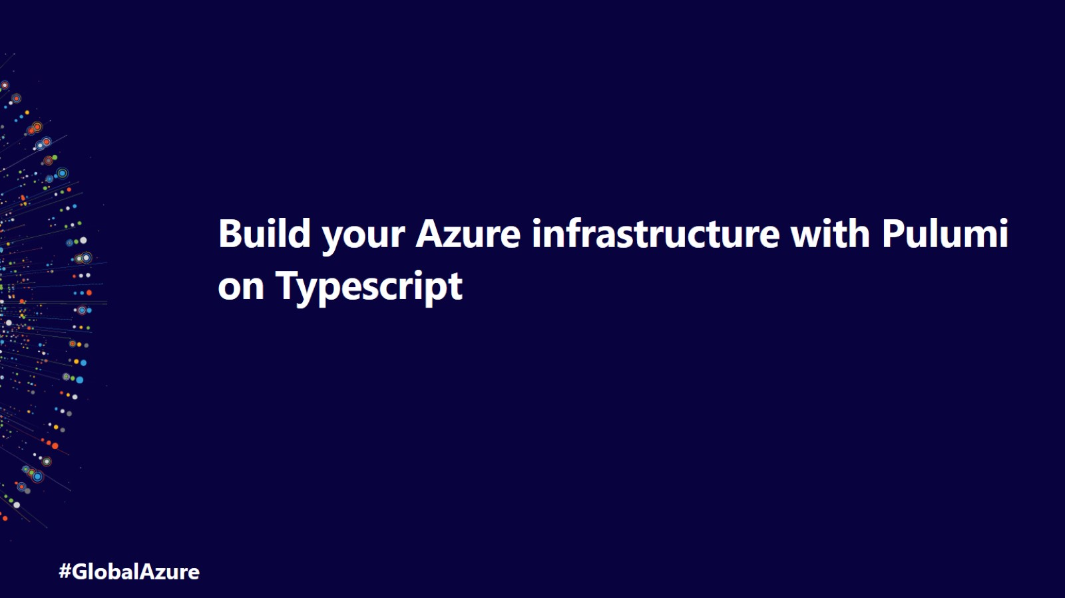
Build your Azure infrastructure with Pulumi on Typescript

Slide 4
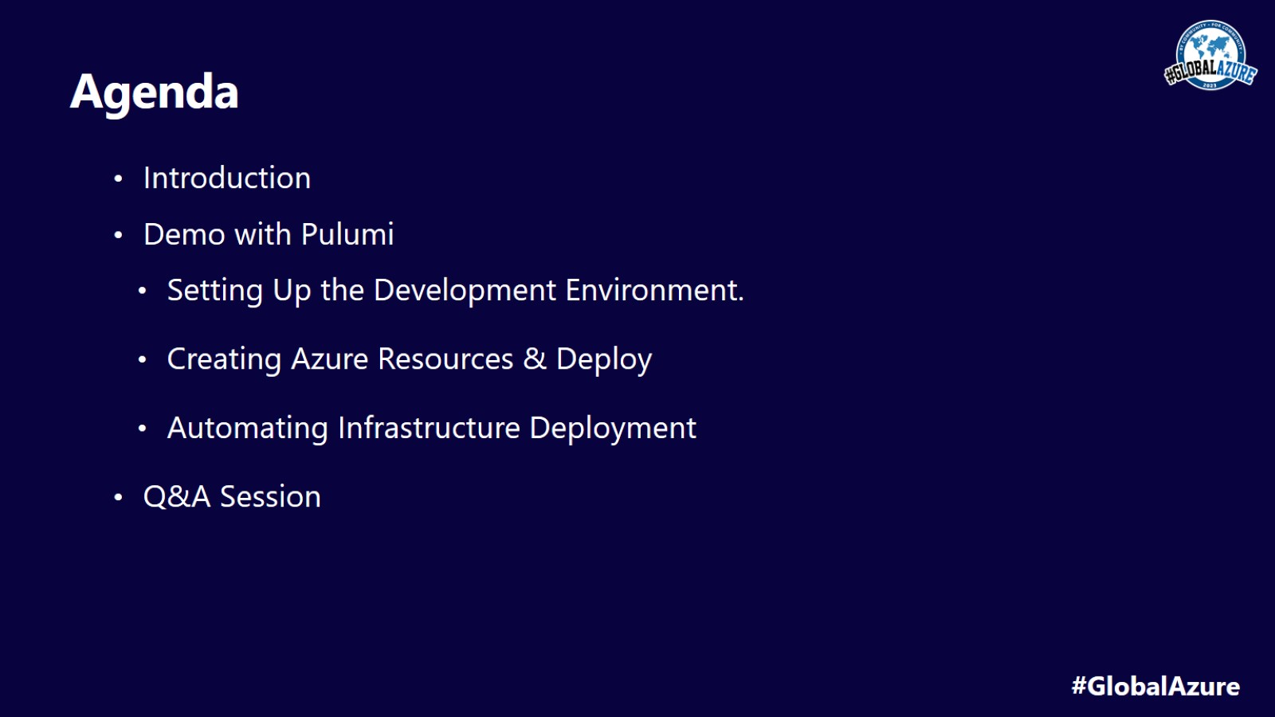
Agenda

Slide 5
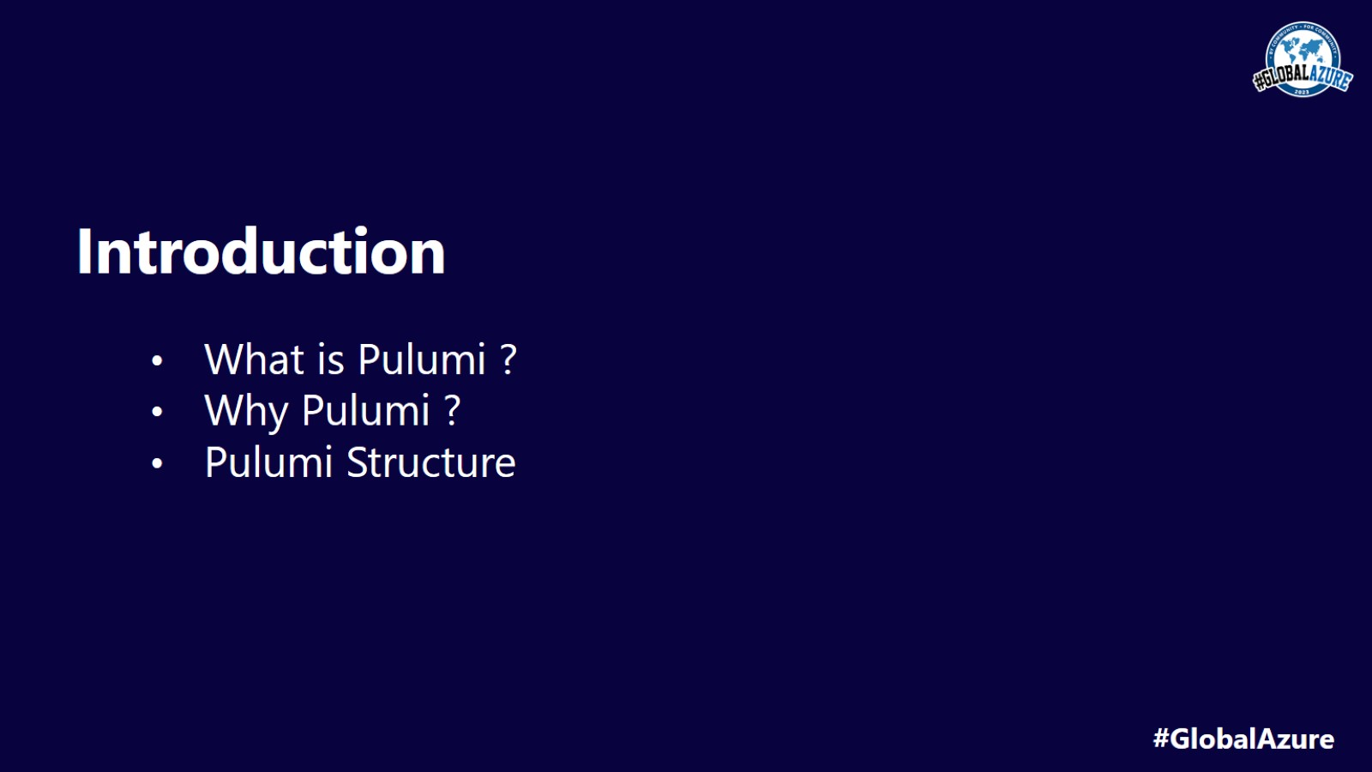
Introduction

Slide 6
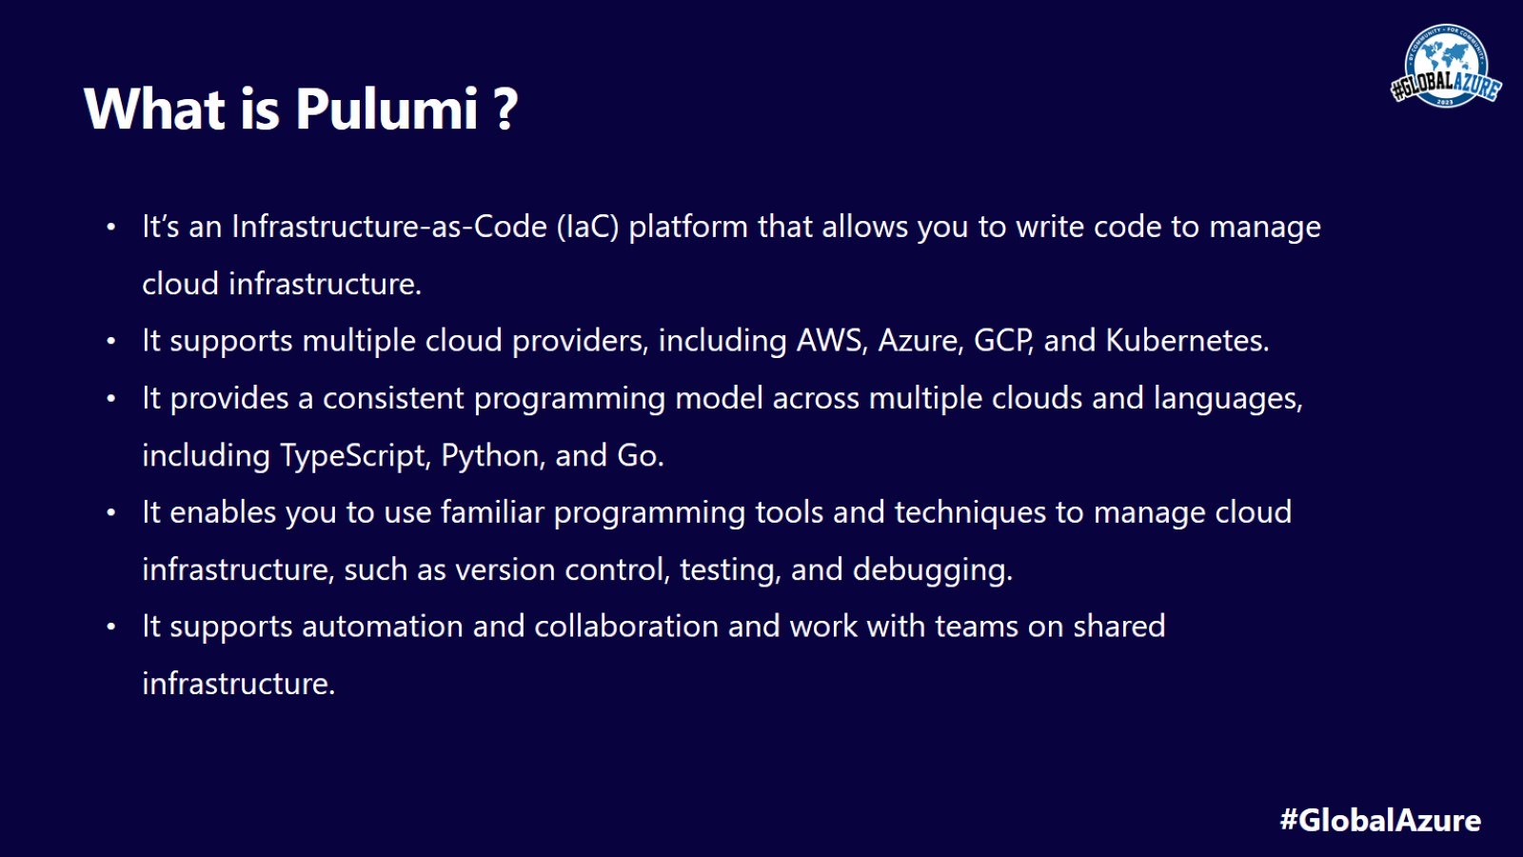
What is Pulumi ?

Slide 7
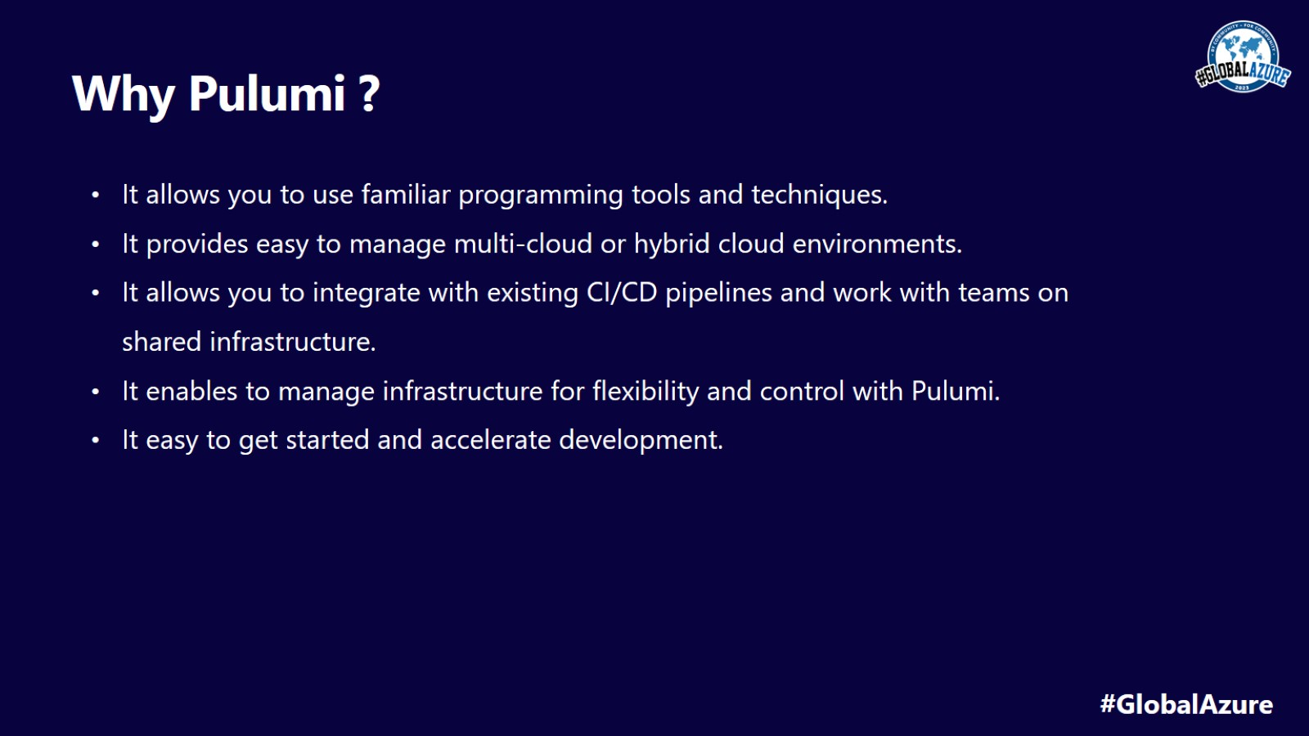
Why Pulumi ?

Slide 8
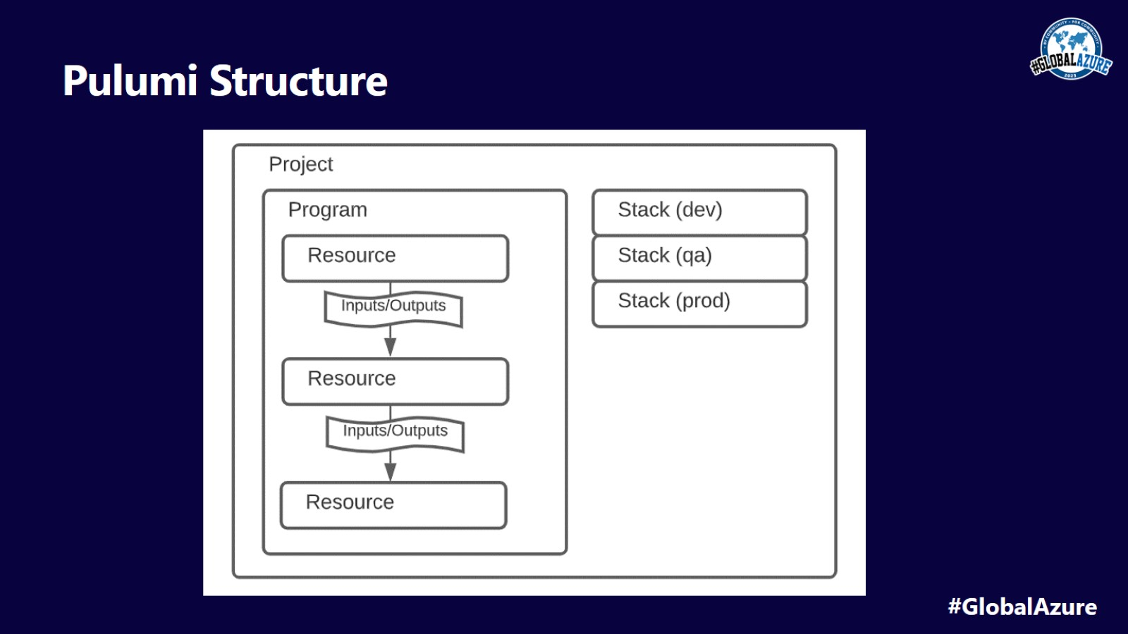
Pulumi Structure

Slide 9
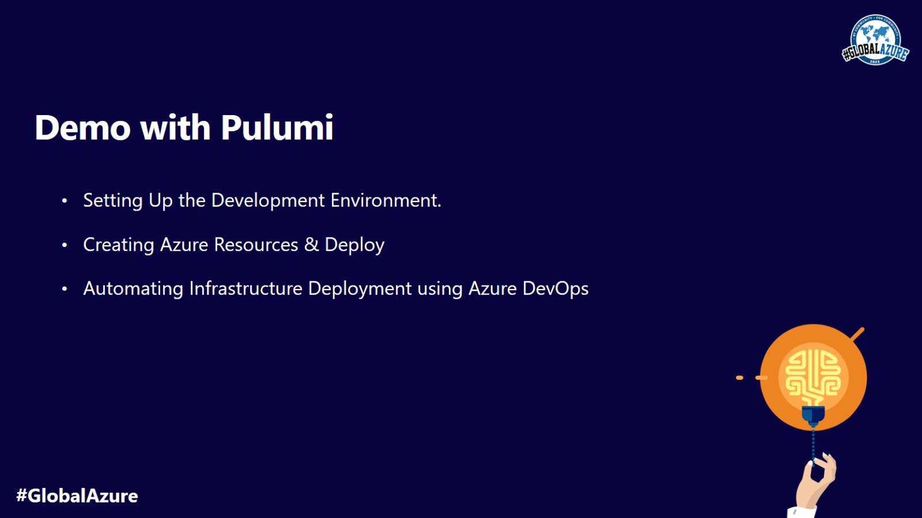
Demo with Pulumi

Slide 10

Q & A

Slide 11
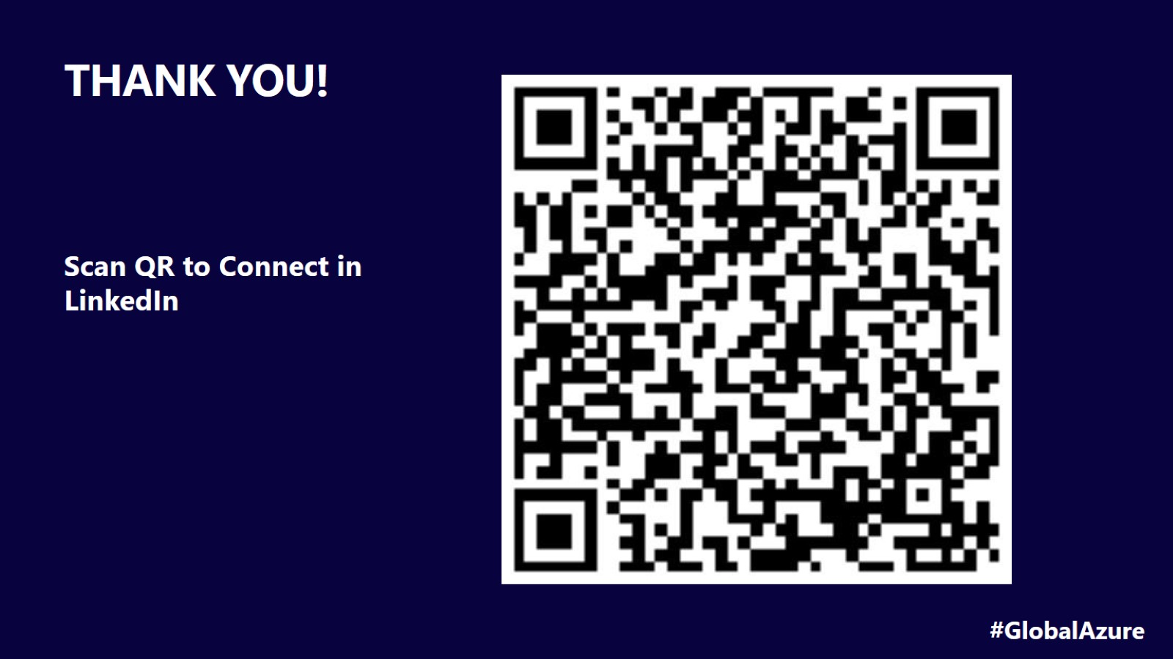
THANK YOU!

